Slide 1
What is DevOps?
DevOps integrates developers and operations teams in order to improve collaboration and productivity by automating infrastructure, automating workflows and continuously measuring application performance.
DevOps is the union of people, process and products to enable continuous delivery of value to end users.
DevOps is not a Technology. It is a culture which combines various tools and technologies for faster delivery of software and feedback loop through CI, CD, CT and CM
For achieving CI/CD, CT & CM a good number of tools and technologies will be used.

Slide 2
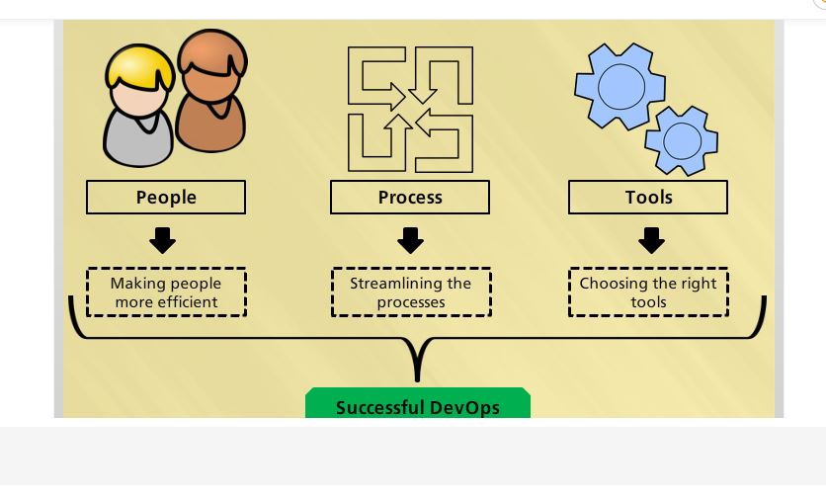

Slide 3
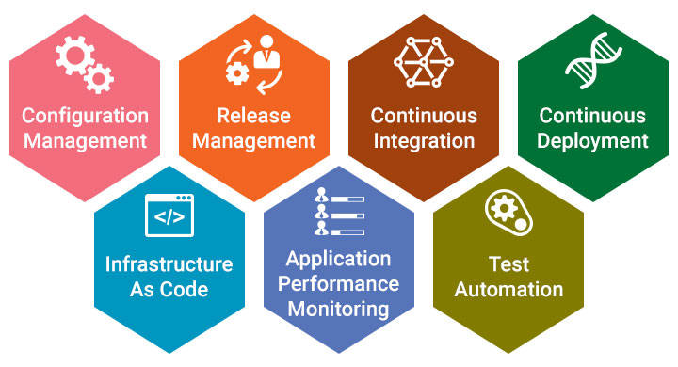
7 DevOps Practices
DevOps Practices
Notes:
DevOps Practices

Slide 4
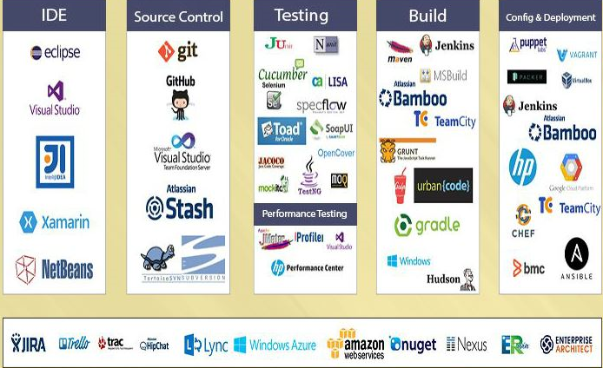
DevOps Tools
Notes:
DevOps Tools

Slide 5
Benefits of DevOps
Developing high quality software
Deploying in frequent cycles
Reducing time to move from idea to implementation
Increased Application / product up time
Increased Productiviy, Revenue & Profitability
Increase in customer satisfaction

Slide 6
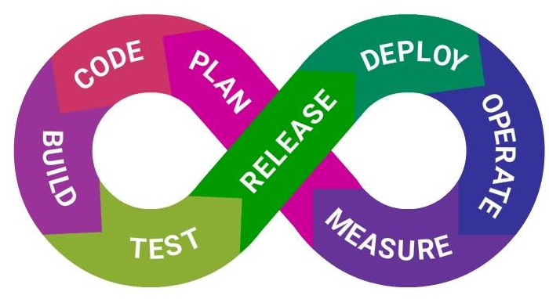
What is CI?
Continuous Integration is a software development practice where members of a team integrate their work frequently, usually each person integrates at least daily - leading to multiple integrations per day. Each integration is verified by an automated build (including test) to detect integration errors as quickly as possible.

Slide 7
Benefits of CI
Continuous Integration does not get rid of bugs, but it does make it easier to find and remove.
When developers cultivate the habit of integrating their code changes regularly:
Changes will be typically small.
Errors can be detected quickly.
Pointing out the change that introduced an error can be done quickly.
Immediate bug detection
A deployable system at any given point

Slide 8
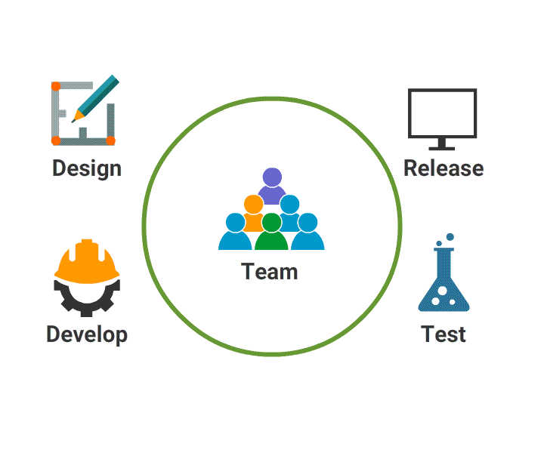
Continuous Integration
Plan for code changes.
Perform the code changes, then compile and test.
Check the results.
Act on the results.

Slide 9
CI Services
Source Code Control
Code Compile
Integrate Database Changes
Run Tests
Code Inspection

Slide 10
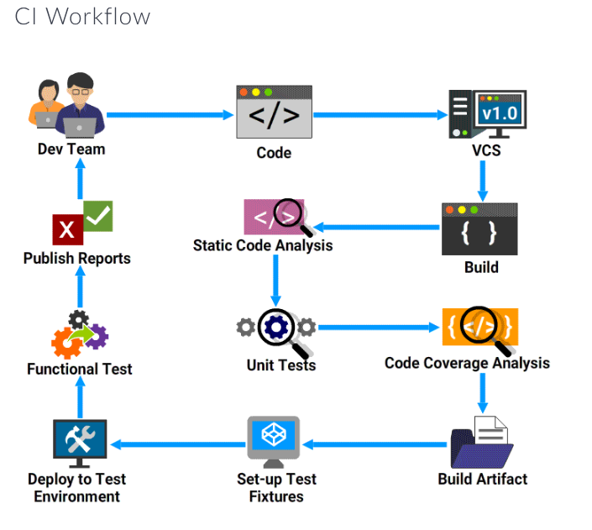

Slide 11

CI Workflow

Slide 12
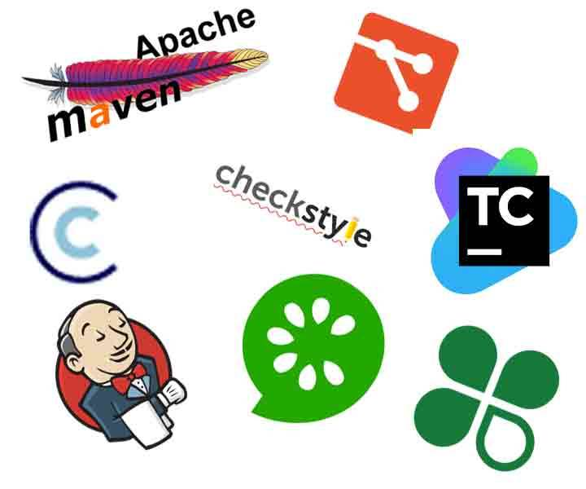
CI Tools
CI Tools
Java build scheduler - Jenkins, Cruisecontrol
Static code analysis : SonarQube, Checkstyle, PMD
Code Coverage : Jcov, Clover, Serenity
Unit Testing : NUnit, JUnit
Functional Testing : Cucumber, Selenium

Slide 13
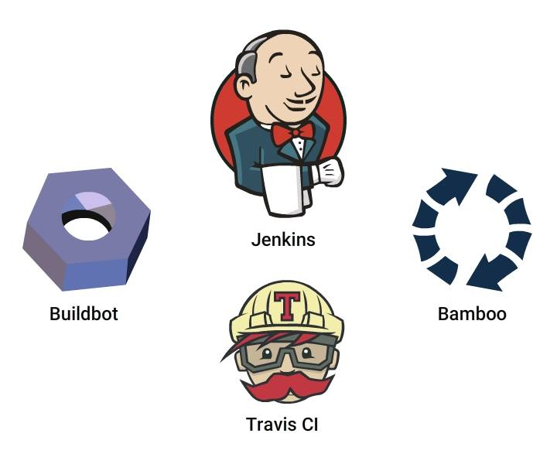
How to enable CI?
You need a tool to create a CI enabled environment. Jenkins, Travis CI, Bamboo,Buildbot are different tools available to enable CI

Slide 14
What is Continuous Deployment?
Continuous Deployment is a software development practice, where software is built in such a way that it can be released automatically to production any time.
CD is a logical extension of Continuous Integration, which together aims at giving developers and end users an incredible experience by:
Detecting bugs at an early stage.
Ensuring seamless deployments to all environments

Slide 15
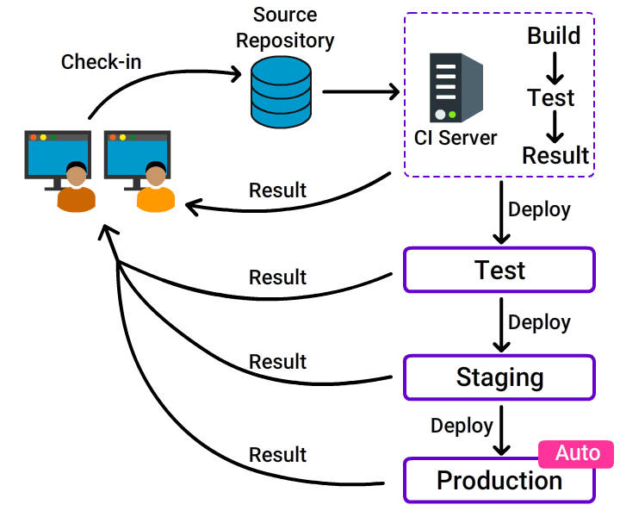
What is Continuous Deployment?
What is Continuous Deployment?

Slide 16
Why CD?
A reliable release is highly at stake when:
The software is deployed manually.
Development is completed and then deployed to a production-like environment.
Lack of proper configuration tools.
Adapt Continuous Deployment for a stable and reliable release.
Reduced cycle time: Reduces the time it takes from the development of code to the changed code being used by users in production.
Zero downtime releases: Frequent deployment of changes enables negligible production downtime.
High quality: Issues detected early and fixed immediately, ensures the best quality of the end product.
Immediate user feedback: Frequent deployment enables quick user feedback.
Notes:
Why CD?

Slide 17
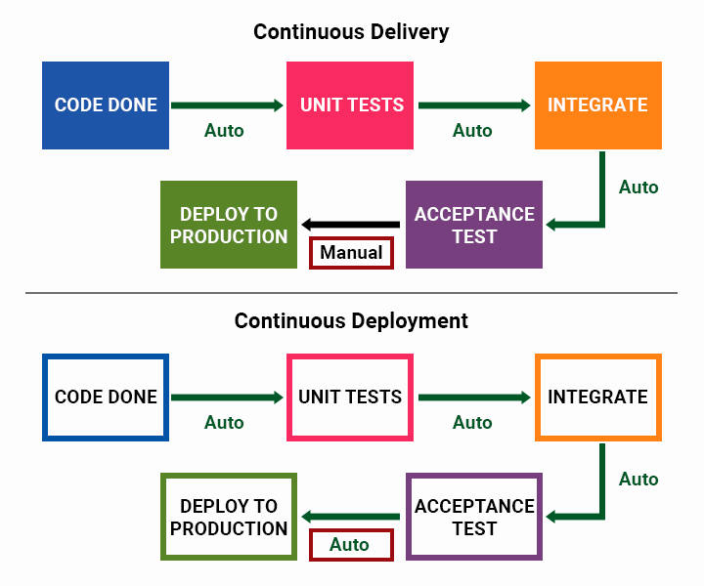
Continuous Delivery and Continuous Deployment

Slide 18
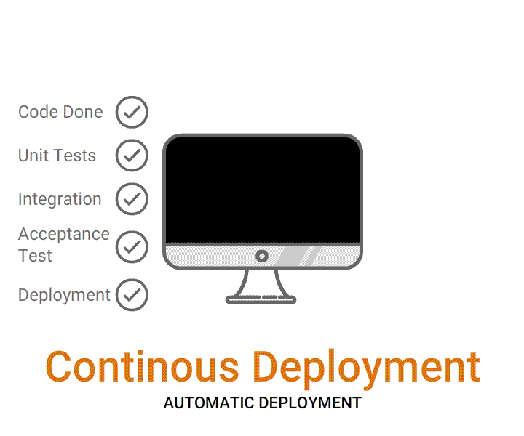
Continuous Delivery vs Continuous Deployment

Slide 19
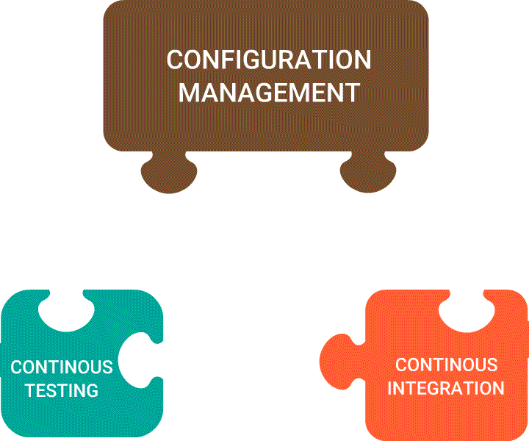
Foundations of CD

Slide 20
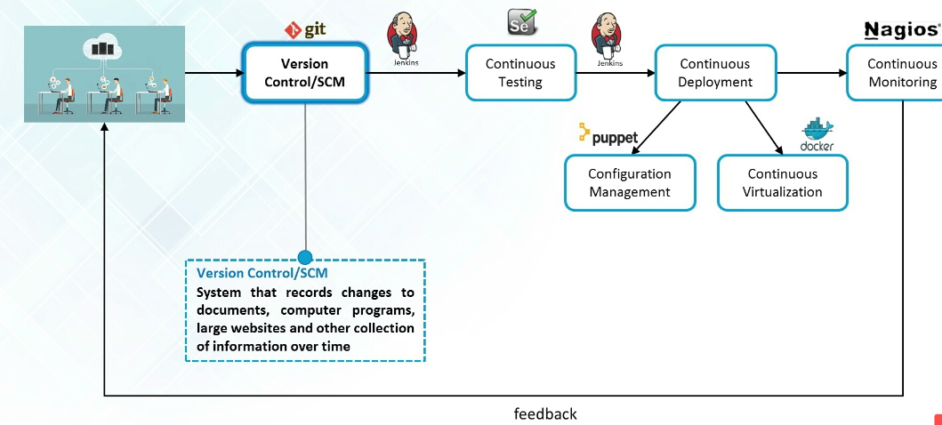
Feedback Loop
Notes:
Feedback Loop

Slide 21
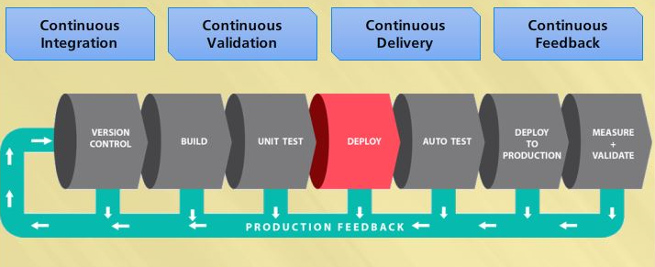
CI/CD Overview
Notes:
Feedback loop

Slide 22
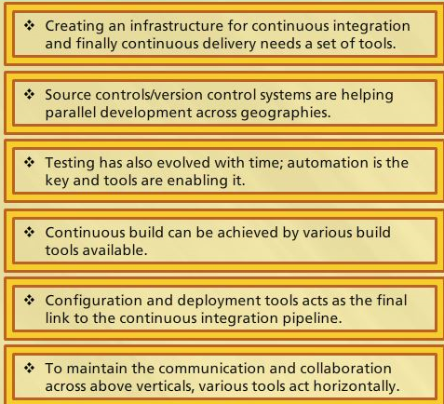
Summary
Notes:
Summary

